Slide 1
Deep Neural Networks
(AIML ZG511)
Dr YVK RAVI KUAMR
yvk.ravikumar@pilani.bits-pilani.ac.in

Slide 2
We thank Prof. P Seetha Parameswaran for the permission to use the PPTs prepared by her
MODULE # 5 :
DEEP FEED-FORWARD NEURAL NETWORKS
(Numerical Examples)
Session 7
(7th June,2026)

Slide 3
Numerical Problem : Forward Propagation

Slide 4
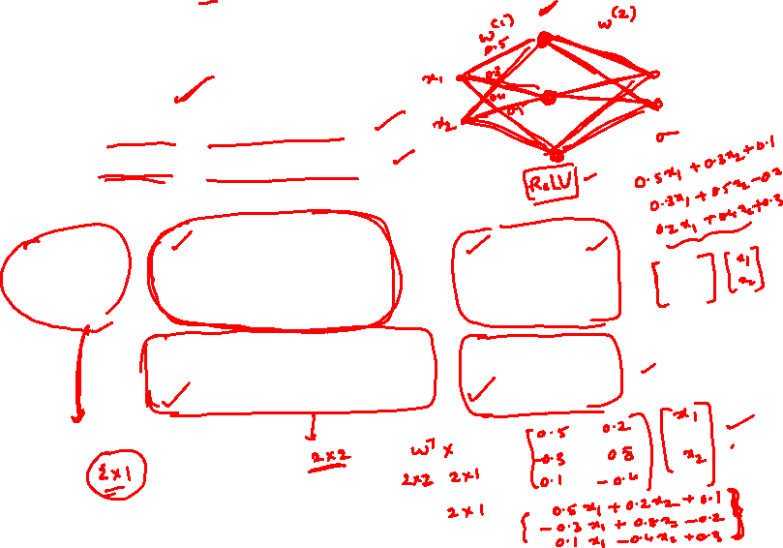
Numerical Problem : Forward Propagation

Slide 8
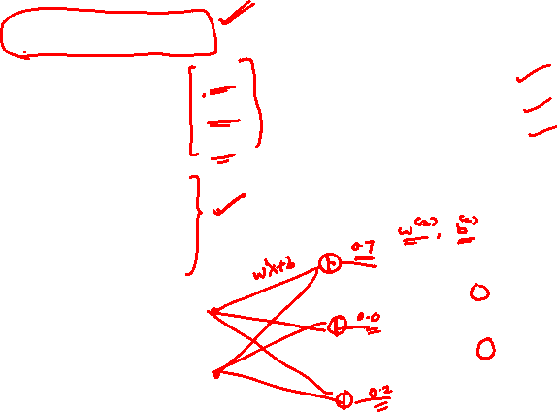

Slide 9
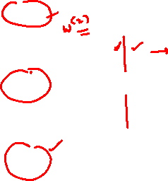

Slide 10
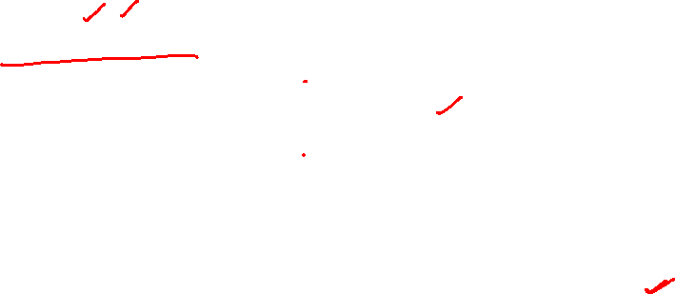

Slide 12
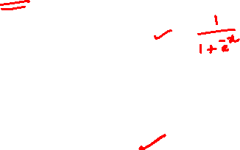

Slide 14
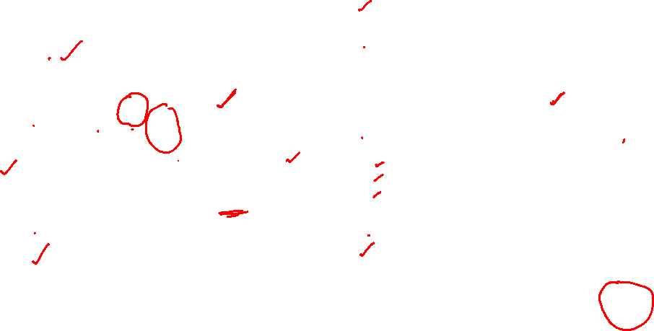

Slide 15
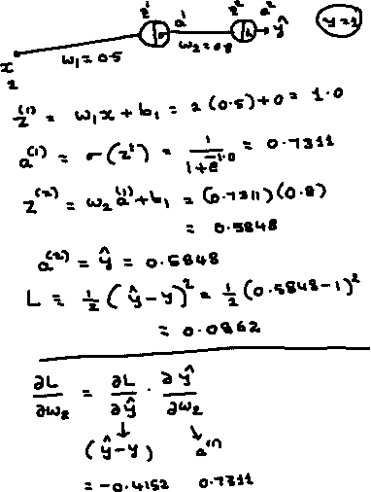

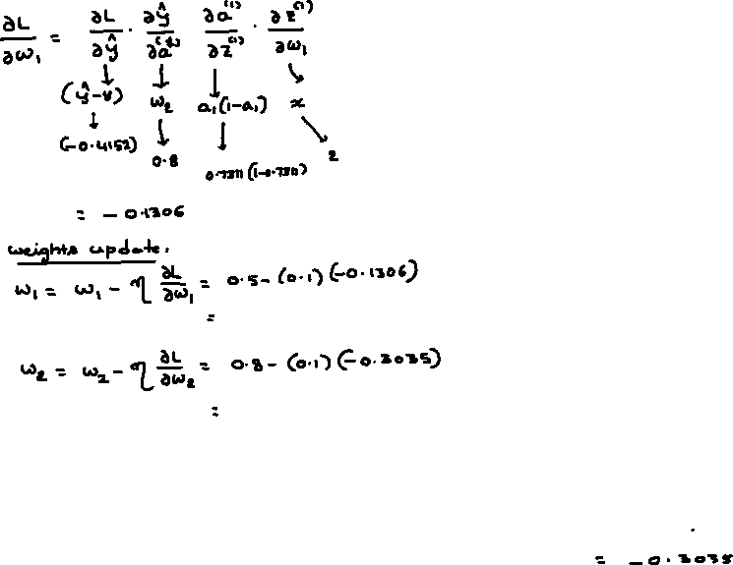
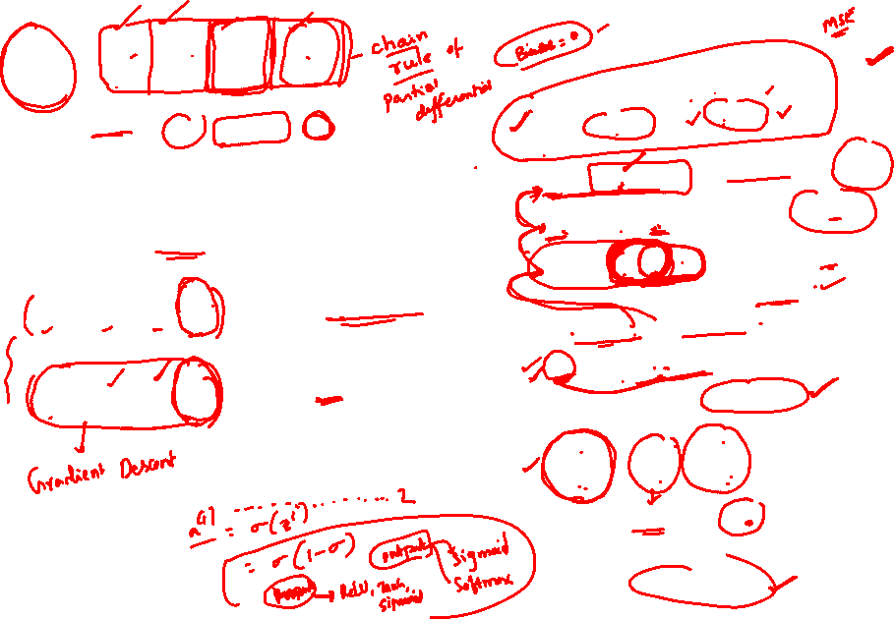

Slide 16
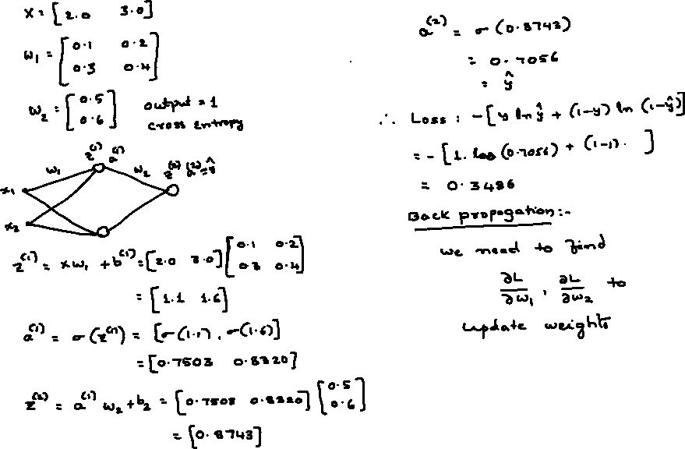
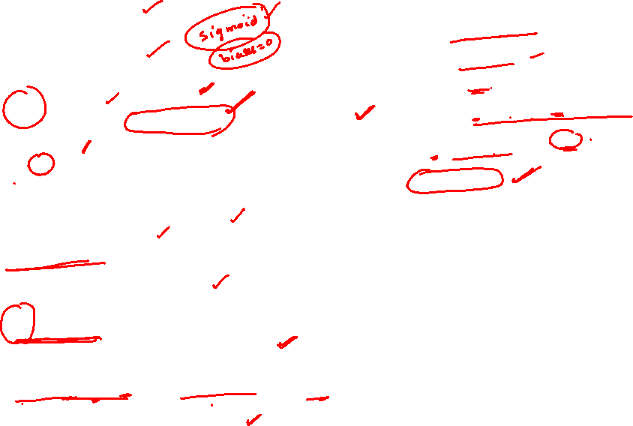

Slide 17
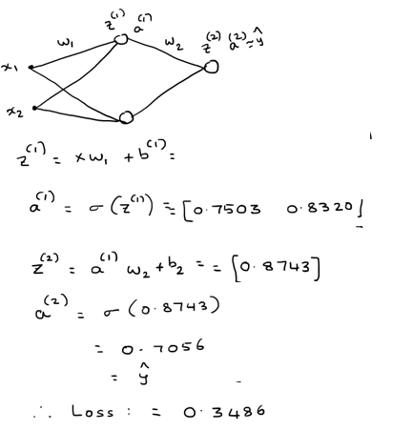
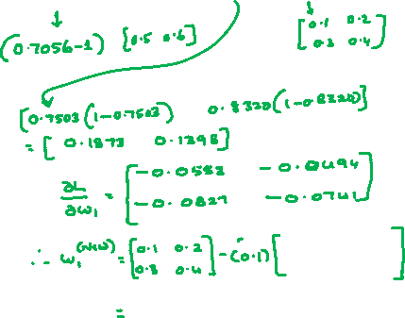
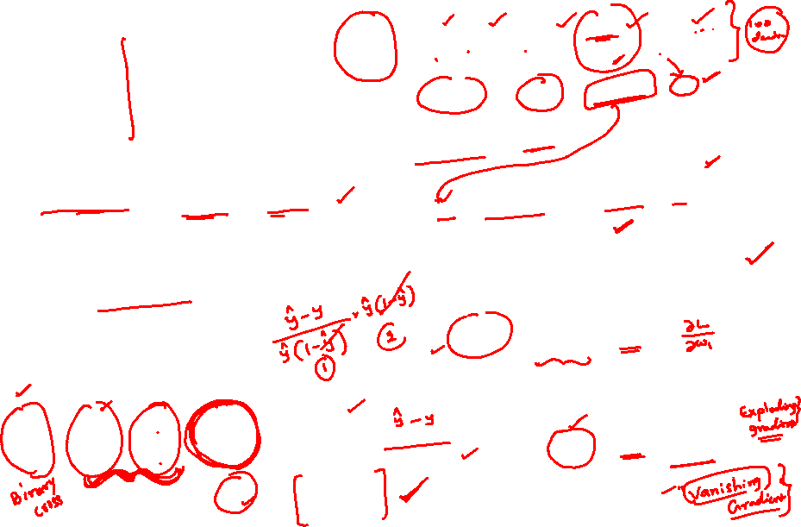
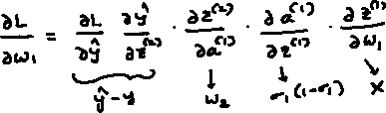
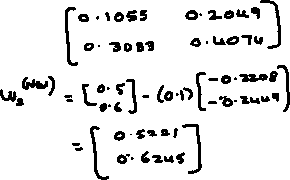
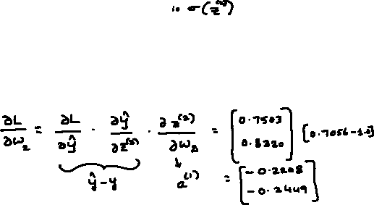

Slide 18
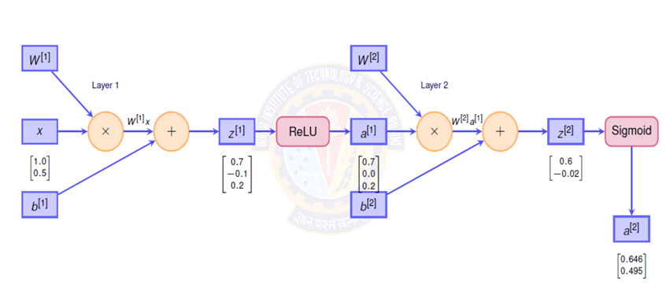

Slide 50
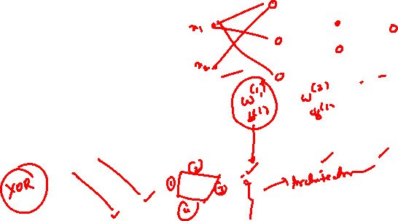

Slide 71
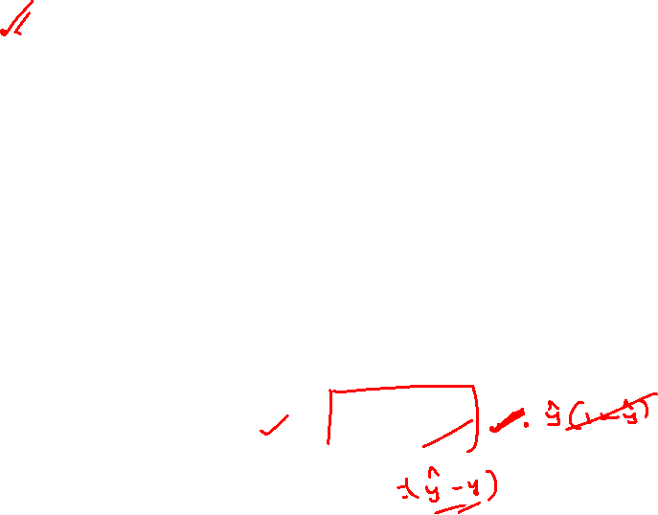

Slide 76


Slide 78
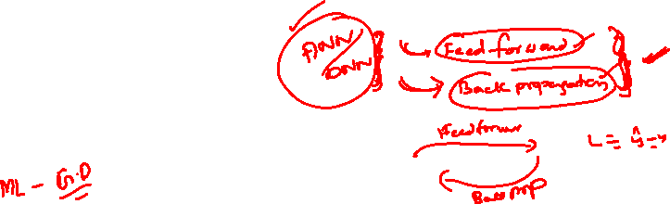

Slide 80

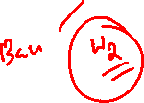
References
Zhang, A., Lipton, Z. C., Li, M., & Smola, A. J. (2023). Dive into Deep Learning. Cambridge University Press. Chapter 4 (Linear Neural Networks for Classification). https://d2l.ai/
Goodfellow, I., Bengio, Y., & Courville, A. (2016). Deep Learning. MIT Press. Chapter 6 (Deep Feedforward Networks). https://www.deeplearningbook.org/
Bishop, C. M. (2006). Pattern Recognition and Machine Learning. Springer. Chapter 4 (Linear Models for Classification).
Murphy, K. P. (2022). Probabilistic Machine Learning: An Introduction. MIT Press. Chapter 10 (Logistic Regression). https://probml.github.io/pml-book/

